Slide 1
Introduction to R
Notes:
STRAW POLL: How many people have used R before? Done datacamp?
Mention – Interaction, questions and feedback is useful to guide timing

Slide 2
The Journey
Session 1
Why R?
Packages
Session 2
Visualization with ggplot2
Session 3
Classification
Data Manipulation with dplyr
R Markdown
Working w Files
Vectors & DF

Slide 3
Preparation Required
Please do the following PRIOR to the presentation
Download R and R Studio unto your local machine
https://cran.r-project.org/bin/windows/base/
https://www.rstudio.com/products/rstudio/download/
Validate that you have successfully installed both by running R Studio

Slide 4
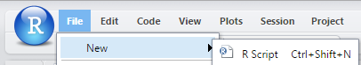
Preparation Required
Please do the following PRIOR to the presentation
Create a new script
Paste the following into the script window
Run all the code in the window CTRL+ALT+R
install.packages (“tidyverse”)
install.packages (“rmarkdown”)

Slide 5

Showing What’s Possible

Slide 6

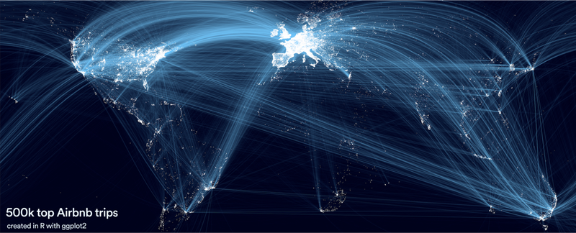

Slide 7
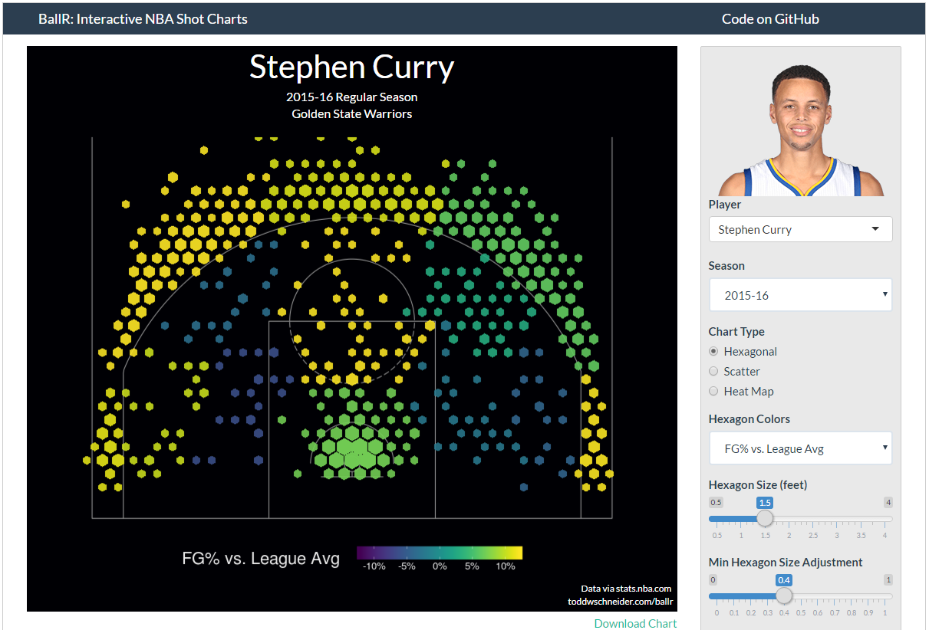

Slide 8
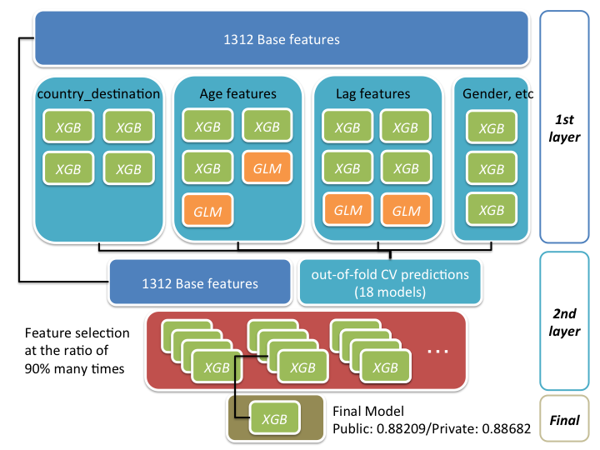

➔

Slide 9
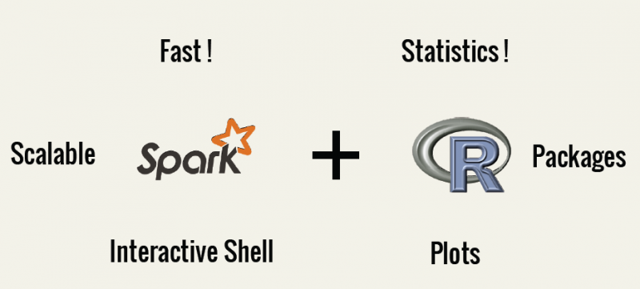

Slide 10



Personal Examples
1
3
2
109th / 2226
Notes:
Machine learning approach to predicting response for marketing campaigns (nearly fully automated methods for prediction, validation, scoring)
Kaggle competition to predict marketing response
2 algorithms used to recommend jobs to users based on their job browsing behaviours

Slide 11
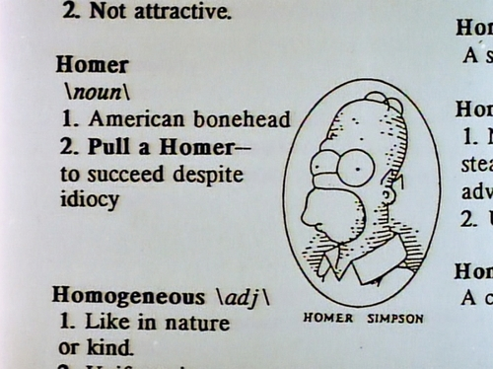
Defining R

Slide 12










What is R? Why is it popular?
Open-source statistical functional programming language with some object-oriented capabilities
Notes:
Big Community
Poweful
Ever Evolving
Very big name users especially in technology

Slide 13

Contrasting Tools
 | R | Python | SAS
GUI-Driven | No | No | Yes
Community |  |  | 
Extensibility |  |  | 
Price |  |  | ✰
Best Background | Stats | Comp Sci | Stats
Graphics |  |  | 
Support | ✰ | ✰ | 
Enterprise Ready |  |  | 
http://blog.datacamp.com/statistical-language-wars-the-infograph/
https://www.analyticsvidhya.com/blog/2017/09/sas-vs-vs-python-tool-learn/
http://www.analyticsvidhya.com/blog/2014/03/sas-vs-vs-python-tool-learn/

Slide 14

Rstudio

Slide 15
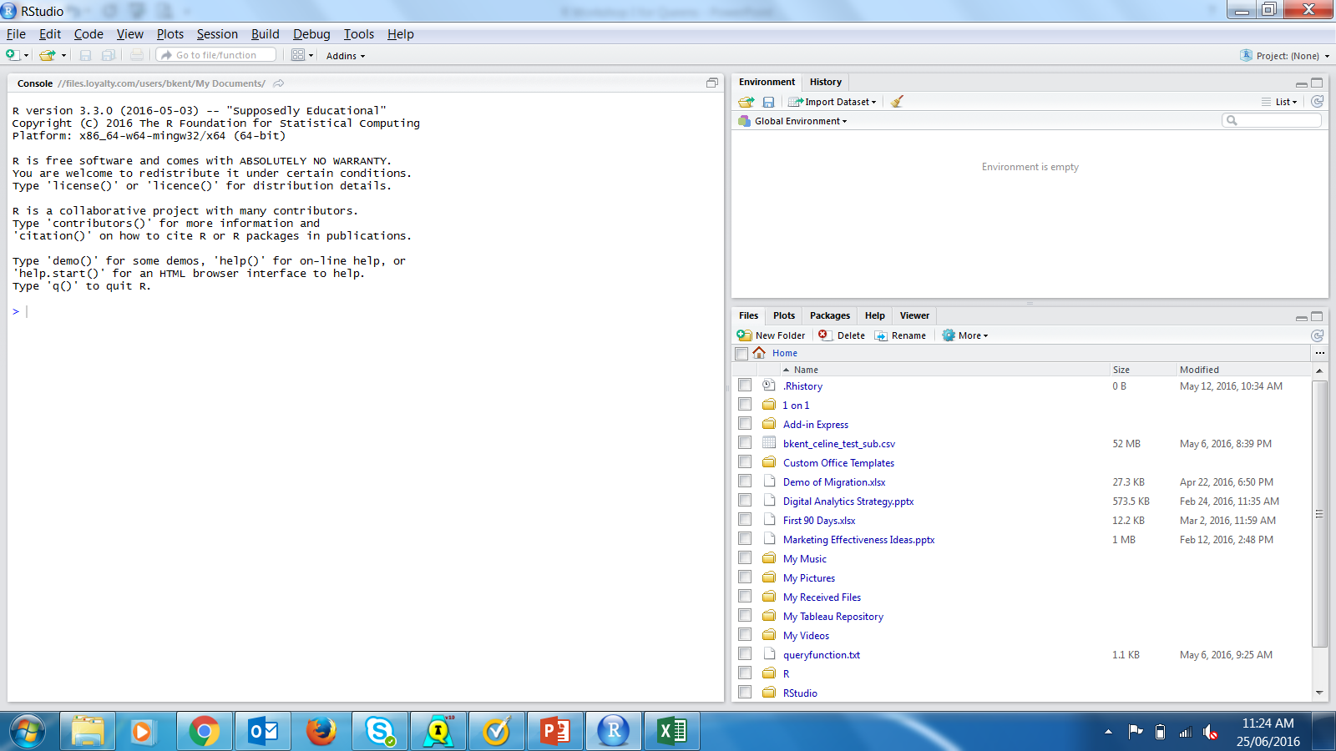
R Studio

Slide 16
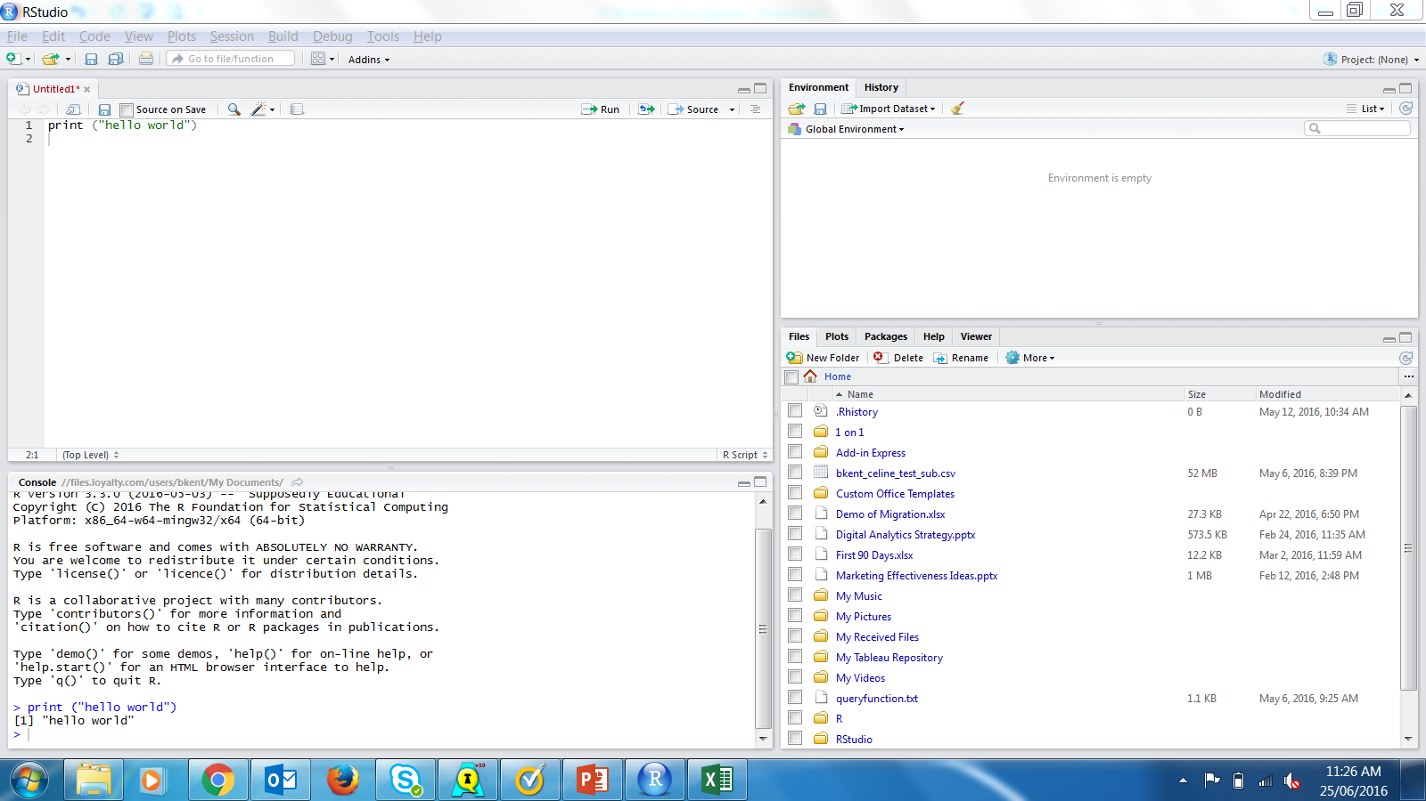
Scripts
Notes:
Create a new script
Type print (“Hello World”)
Show to run the code
To run all code you can hit Run buttom
To run a single line of code you can simply be on that line and hit CTRL + ENTER
How to Save
How to Load

Slide 17
Console
Notes:
Output goes here
Can stop long running code here

Slide 18
Environment
Notes:
Objects in memory

Slide 19
Files/Plots/Help
Notes:
Files – Can load or export here, shows where you’re working directory is
Plots – Shows plots here
Packages – Shows your packages here
Help – Shows help items

Slide 20
Keyboard Shortcuts
https://support.rstudio.com/hc/en-us/articles/200711853-Keyboard-Shortcuts
Most important shortcut:
Run current line/selection | Ctrl+Enter | Command+Enter

Slide 21

Packages

Slide 22
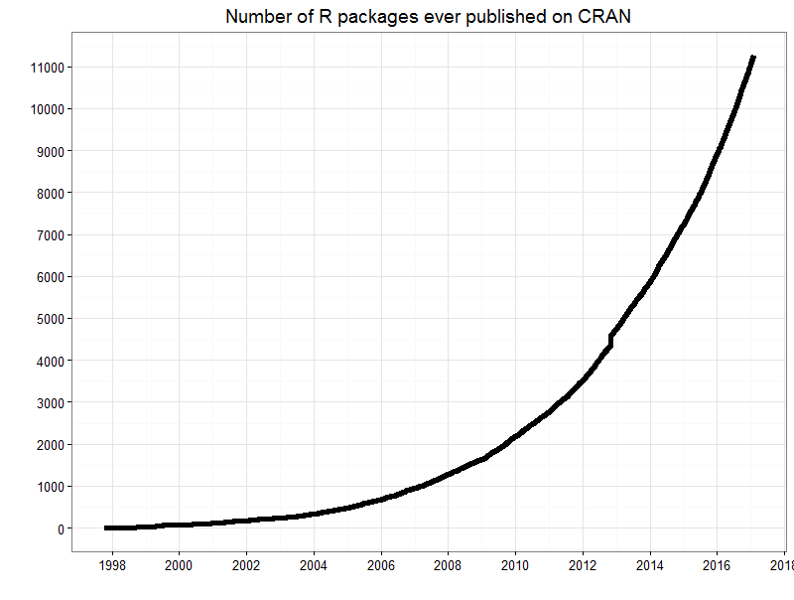

Packages – Your AppStore for Analytics
Examples of Packages Updated/Launched Apr 21/16
Statistical Toolbox for Radiometric Geochronology
Tools for Interacting with 'PostgreSQL' / 'PostGIS' Databases
Emoji Fonts for using in R

Slide 23






Packages by Key Areas
parallel – running operations in parallel
data.table – package for faster tables
bigmemory – solution to massive matrices
sparkr – integration with spark clusters
lubridate – easy data manipulation
forecast – ARIMA and exp smoothing
caret – predictive modeling meta package
tm – text mining package
arules – association rules (market basket)
xgboost – gbm Orange
dplyr – very good data manipulation
stringr – better string manipulation
reshape – pivotable like analysis capabilities
RODBC – obdbc connector
XLConnect – write excel files from R
foreign – read SAS files
ggplot2 – Best graphic package
shiny – interactive web app
ggmap – GIS plotting using googlemaps
https://support.rstudio.com/hc/en-us/articles/201057987-Quick-list-of-useful-R-packages

Slide 24
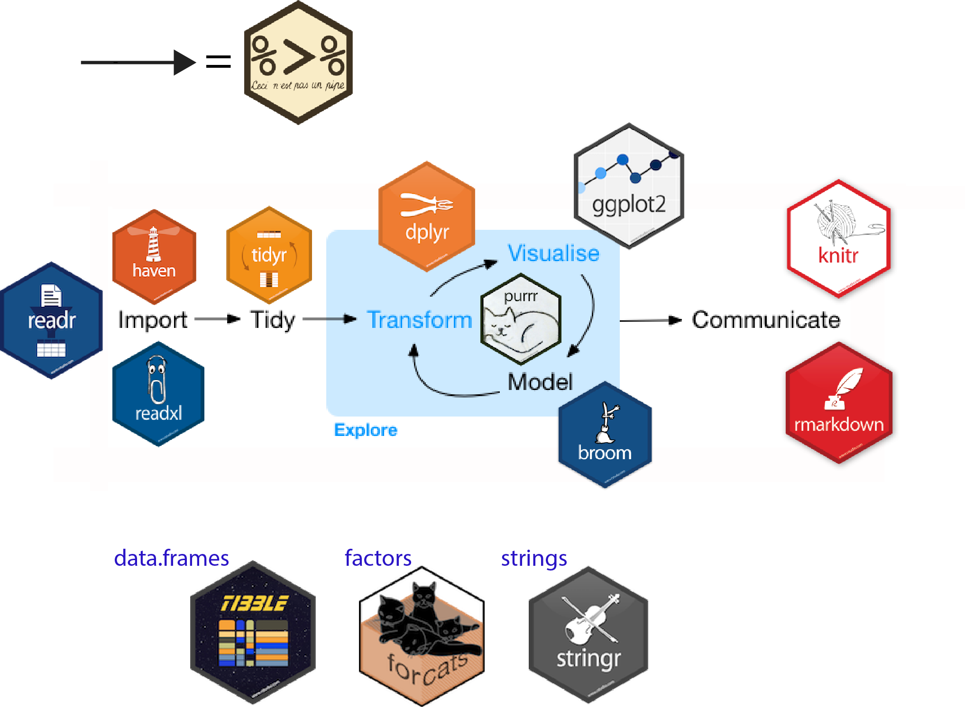
TidyVerse
The tidyverse is an opinionated collection of R packages designed for data science. All packages share an underlying design philosophy, grammar, and data structures.

Slide 25
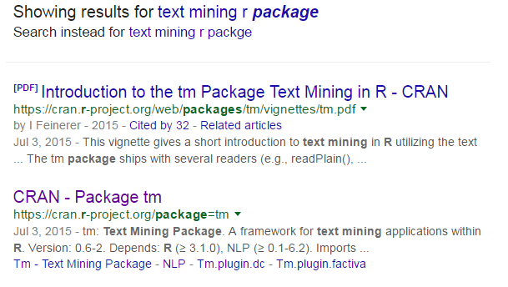
Packages - Finding, Loading, Installing Packages
With R, always remember some other smart person probably faced this problem. How did they solve it? Use Google to search for options.
“text mining R package” ➔
CRAN – Comprehensive R Archive Network – hosts every package so if you see that site, it’s likely a package you’ve found

Slide 26
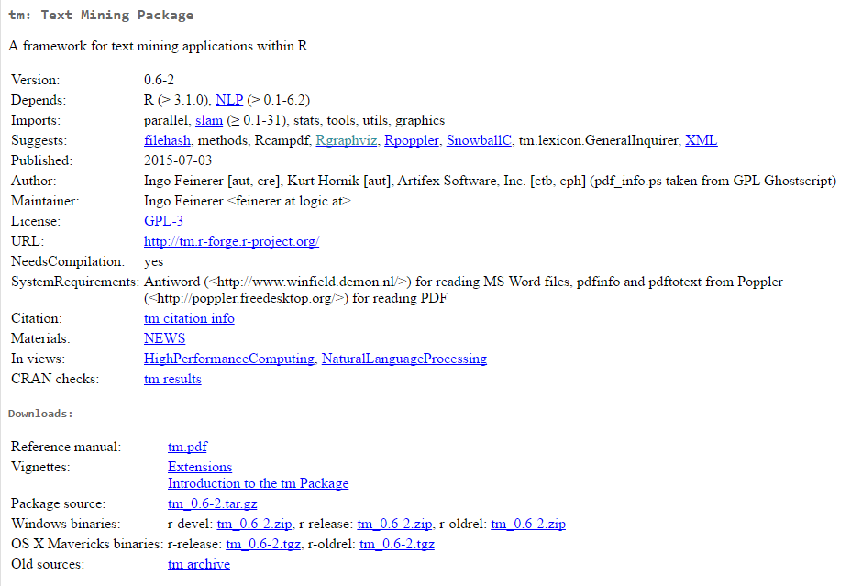
Where to look for examples and references
Notes:
The vignette will give you a solid practical example of how to use it on a toy data set. The reference manual will go through all functions.

Slide 27
Packages - Finding, Loading, Installing Packages
Now you just need to install and load it!
Case matters. If you get an error installing the package, read it and try to determine the error. Google if it’s not obvious.
> install.packages ("tm")
> library (tm)

Slide 28
Objects – Example Continued
Back in the realm of R, the print() function executes different things when it is applied to a variable vs. complex object such as lm (linear regression)
Use the arrow operator “<-” to declare an object
CLASS: lm
CLASS: numeric
> data(Orange)
> res <- lm(age ~ circumference, data=Orange)
> print(res)
Call:
lm(formula = age ~ circumference)
Coefficients:
(Intercept) circumference
16.604 7.816
> a <- 5
> print(a)
[1] 5
Method
Print()
Method
Print()
Notes:
CC
Must introduce the <- assignment operator

Slide 29
Warmup
Hello World
Case Sensitive (Print vs. print)
1+1
Assignment (a <- 1 vs a = 1 vs. a == 1)
Comments ##
?Help (me)
Stop Sign

Slide 30
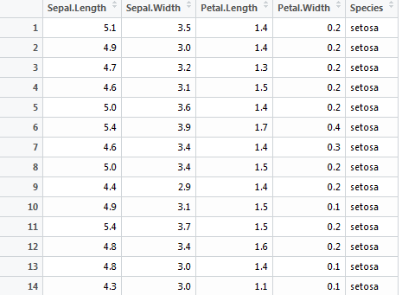
How R Thinks About Data
Vector of Numbers
Row
Vector of Strings

Slide 31
How R Thinks About Data
A dataframe is what you will be using most of the time. When you have more than 1 vectors and they are not all numeric, that’s a dataframe. If you had only numbers you could use a special type called a matrix.
Dataframe

Slide 32
How R Thinks About Data
Column Names
For convenience you have names for both rows and columns. These will become very important for manipulation.
Row Names

Slide 33
Basic Data Types
When you define a “variable” in R they are technically objects, and every object can be classified by its “type”, also known as a mode.
Most common modes are
Numeric
Character
Logical
> age <- 23
> mode(age)
[1] “numeric”
> name <- “Brad”
> mode(name)
[1] “character”
> tall <- TRUE
> mode(tall)
[1] “logical”
Notes:
CC

Slide 34
Use RMarkdown
RMarkdown Intro
Working with Files
Vectors & Dataframes
Comparisons & Logic

Slide 35
Appendices

Slide 36
Basic Data Types - Factors
Factors are a special variable type that often represent categorical variables. They become important when you want to do predictive models because many packages expect some variables to be factors.
A factor is stored in memory as a integer vector mapped to a label
> data (iris)
> mode(iris$Species) # Find out its “basic data type”
[1] "numeric"
> is(iris$Species) # List every structure it is: it’s a numeric vector but also a “factor”
[1] "factor" "integer" "oldClass" "numeric" "vector" "data.frameRowLabels"
> str(iris$Species) # Print the “structure” of this variable
Factor w/ 3 levels "setosa","versicolor",..: 1 1 1 1 1 1 1 1 1 1 ...
> levels(iris$Species)
[1] "setosa" "versicolor" "virginica"
Notes:
CC
Make sure we introduce the concept of the $ operator

Slide 37
Coercing Data Types or Objects
You will often need to change the data type of your data to other types which is easily done. In the previous slide we found out Species variable was “numeric”, but also a factor that is mapped to a label. Watch what happens when we coerce the data type.
Other conversions:
> as.character (iris$Species)
> [1] "setosa" "setosa" "setosa" "setosa" "setosa" "setosa" "setosa"
> as.numeric (iris$Species)
[1] 1 1 1 1 1 1 1 1 1 1 1 1 1 1 1 1 1 1 1 1 1 1 1 1 1 1
as.factor()
as.logical()
as.numeric()
as.matrix()
as.data.frame()
Notes:
CC

Slide 38
Introduction to Dataframe
You can create a data frame in multiple ways:
To review the structure of a dataframe you can use str
The names aren’t helpful so let’s add some
a <- c(1,2,3,4,5) #numeric vector
b <- c("one", "two", "three", "four", "five") #string vector
df <- data.frame(a, b)
str(df)
'data.frame': 5 obs. of 2 variables:
$ a: num 1 2 3 4 5
$ b: Factor w/ 5 levels "five","four",..: 3 5 4 2 1
colnames (df) <- c(“Numbers”, “Strings”)
str (df)
'data.frame': 5 obs. of 2 variables:
$ Numbers: num 1 2 3 4 5
$ Strings: Factor w/ 5 levels "five","four",..: 3 5 4 2 1
Notes:
CC

Slide 39
Accessing the Dataframe
The easiest way to access the Dataframe is using the single square bracket “[]” operator
[ row , column ]
Example:
data [ 3, 5 ] access the element on the 3rd row and 5th column
data [ 3, ] access all the elements in the 3rd row
data [ , 5 ] access all the elements in the 5th column
data [ c(1:4) , ] access all the elements from 1st to 4th row
data [ 3, c(1: ncol(data)– 1) ] access all elements on the 3rd row except for last column
What does data [ -4, ] access?
Notes:
CC

Slide 40
Playing with Vectors
Any column in a dataframe is a vector. Vectors can also be a separate data object usually created with a c() function.
Note that the default method for simply executing the name of an object is the print() function. This can be bad if you have a large data set.
> a <- c(1,5,4)
> a
[1] 1 5 4
#Print the first element of vector a
> a [2]
[1] 5
Notes:
CC

Slide 41

Functions to Inspect Your Data
Head shows you the top N rows
head (iris,2)
These functions show df dimensions
Length shows you vector length
dim(iris)
ncol(iris)
nrow(iris)
dim[2]
ncol
> length(iris$Species)
[1] 150
dim[1]
nrow

Slide 42
Setting your Working Directory
Your working directory is where all your files are most accessible. On a windows machine, it’s often under your My Documents. To find out where it is set by default used getwd()
Note the forward slash. You must use forward slashes even in Windows!
> getwd()
"c:/users/bkent/My Documents"
> setwd("c:/R")

Slide 43
Importing & Exporting
Exporting CSV
> write.csv (iris, file = "iris.csv", row.names = FALSE)
Importing CSV
DON’T FORGET
> iris2 <- read.csv ("iris.csv")
Saving R Objects
> save (iris, "iris.r")
> load ("iris.r")

Slide 44

1 - Workshop
First map your local directory to something you prefer using setwd().
Load the CSV into R and save it to a dataframe named “springleaf”
How many rows and columns are there? What’s the total cell count?
Run the summary() function on the first 10 columns of the dataset
Create a new variable (separate from the springleaf dataframe) that stores the length of the ID variable in the springleaf dataframe
Notes:
5 min

Slide 45

Logical Conditions

Slide 46
Logical Conditions
Knowing how to work with logical vectors enables you to check very complicated conditions in compact powerful ways
%in% checks if the vector has items in it
== equal to
!= not equal to
| “or” operator
& “and” operator
! “not” operator (inverses logicals)
This is partly why using <- vs. = can help you avoid mistakes where instead of checking a logical condition with == you are changing values.

Slide 47
Logical Conditions
> a <- c(1,2,3,4)
> b <- c(1,2,3,4)
> c <- c(9,9,9,9)
> #generate logical vector comparing the string vectors
> TRUES <- a == b
> FALSES <- a == c
> #check each position to see if vectors has value of TRUE
> TRUES & FALSES
[1] FALSE FALSE FALSE FALSE
> #check each position to see if vectors either vector has a TRUE
> TRUES | FALSES
[1] TRUE TRUE TRUE TRUE
> #Is NOT TRUE equal to FALSE?
> !TRUES == FALSES
[1] TRUE TRUE TRUE TRUE

Slide 48
Logical Conditions
Let’s use the very powerful %in% operator
This becomes extremely useful later when we want to subset data based on conditions.
> a <- c(1,2,3,4)
> a %in% c(2, 3)
[1] FALSE TRUE TRUE FALSE

Slide 49
2 - Workshop
Look up the complete.cases() function in help and read what it does.
Now use the complete case function to generate a logical vector. Now try to pass that vector into the function table () which we will cover soon. What would you conclude about the data set?
Now check the variable VAR_0237… what type is it? Now, determine the proportion of states that are either CA, NY or NJ?
Let’s add a TRUE / FALSE variable for whether the state is in the CA/NY/NJ list to our exising springleaf dataframe

Slide 50

Basic Functions

Slide 51
Basic Functions – Summary Statistics
R has all of the basic functions you would expect from a statistics perspective
> sum (iris$Petal.Width)
[1] 179.9
> mean(iris$Petal.Width)
[1] 1.199333
> median(iris$Petal.Width)
[1] 1.3
> quantile(iris$Petal.Width)
0% 25% 50% 75% 100%
0.1 0.3 1.3 1.8 2.5
> sd(iris$Petal.Width)
[1] 0.7622377

Slide 52
NAs and Handling Them
NA and NaN are special values
NA represent missing values in a data set
NaN typically occur when a division by zero occurs
The springleaf data set is rife with these NA issues as we saw from complete.cases()
Key Functions
complete.cases() → checks the row for any presence of NA
is.na() → checks a vector for NA
na.omit() → will remove rows with NAs detected
Many functions won’t run properly with NAs but provide a parameter to ignore the NAs on a calculatuion

Slide 53
3 - Workshop
All these NAs need to be fixed.
Try running table (is.na()) on VAR_0207, VAR_0213 and VAR_0840
Now let’s remove these 3 columns. One simple way is to use:
Try running complete.cases() again without those 3 variables
Next let’s try to run the mean VAR_0006.
Fix the issue by using the parameters in the mean function.
springleaf$VAR_0207 <- NULL
Notes:
5 min

Slide 54
Basic Functions – Cut / Seq
seq builds a vector of numbers but is very versatile
cut takes a vector and places it into bins (e.g. classify a record by decile)
#seq (start, end, by)
> seq (1, 5, 1)
[1] 1 2 3 4 5
> seq (5, 1, -1)
[1] 5 4 3 2 1
> a <- seq (0,10,1)
> cut (a, c(-Inf,3,6, 9, Inf))
#Quick outlier detection
> a <- c(-1,3, 3, 3,3,3,3,4,5,5,5,6,7,10,16)
> b <- cut (a, c(-Inf, mean (a) - 1.5*sd(a), mean(a)+1.5*sd(a), Inf))
> b

Slide 55
4 - Workshop
Run the mean, median and quartile functions for VAR_0583.
Do you see an issue with the data?
Can you fix the issue and create a new cleaned variable?

Slide 56
Basic Functions – Table
table function allows you to run frequency tables mimicking SAS Proc Freq
You can easily take that table and get the proportions by column or row
You can also convert these tables to dataframes for lots of extensions
> a <- c(1,1,1,2,2,2,3,3,3)
> table (a)
a
1 2 3
3 3 3
> prop.table (table (a))
1 2 3
0.3333333 0.3333333 0.3333333
> df <- as.data.frame (prop.table (table (a)))

Slide 57
Basic Functions – Sample/Seed
In order to do any machine learning, you obviously need to be able to sample data. sample (vector, number of obs to sample)
For reproducible results, you should always set the seed before sampling steps. This ensures that the step will return the exact results.
Stratified sampling is possible using packages like strata
> set.seed (101)
> IDs <- sample (springleaf$ID, size = nrow (springleaf)*.0001)
> IDs [1]
[1] 25307

Slide 58
5 - Workshop
Let’s create two data sets, one for training (75%) and one for validation (25%).
Use table to validate that the target variable proportion is consistent between the two data sets.
Validate that all IDs have been allocated to either test or validation

Slide 59
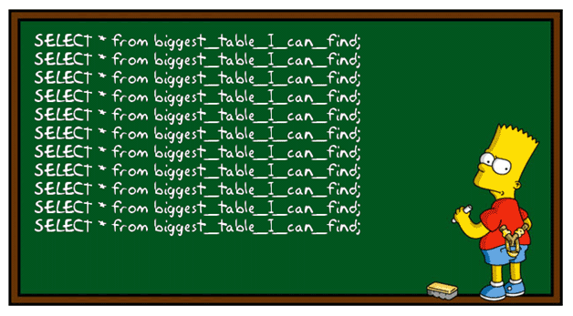
Manipulating Data

Slide 60
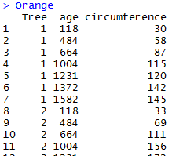
Manipulating Data
Manipulation of data in R relies on matrix operations, functions and packages. We will begin by looking at few examples to better understand how R handles data manipulation, then learn how to use 2 of the most powerful packages in R.
Summary Functions
Subsetting
Ordering
Merging
Notes:
CC

Slide 61
Subsetting Data
Example: Select records with age of the tree older than 1000 years
The following expression creates a matching array of logical expressions, all elements that are matched with TRUE is picked up
Use the single square bracket to subset the data
> Orange$age
[1] 118 484 664 1004 1231 1372 1582 118 484 664 1004 1231 1372 1582
[15] 118 484 664 1004 1231 1372 1582 118 484 664 1004 1231 1372 1582
[29] 118 484 664 1004 1231 1372 1582
> Orange$age > 1000
[1] FALSE FALSE FALSE TRUE TRUE TRUE TRUE FALSE FALSE FALSE TRUE TRUE TRUE TRUE
[15] FALSE FALSE FALSE TRUE TRUE TRUE TRUE FALSE FALSE FALSE TRUE TRUE TRUE TRUE
[29] FALSE FALSE FALSE TRUE TRUE TRUE TRUE
> Orange$age [ (Orange$age > 1000) ]
[1] 1004 1231 1372 1582 1004 1231 1372 1582 1004 1231 1372 1582 1004 1231
[15] 1372 1582 1004 1231 1372 1582
# What would age [ !(age > 1000) ] do?
Notes:
CC

Slide 62
Ordering Data
Sorting data in R uses a similar concept
order function returns a integer-index, indicating which order the row corresponds to.
Advantage of order function: can be used for multi-dimensional data
> Orange$circumference
[1] 30 58 87 115 120 142 145 33 69 111 156 172 203 203 30 51 75 108 115
[20] 139 140 32 62 112 167 179 209 214 30 49 81 125 142 174 177
> order(Orange$circumference)
[1] 1 15 29 22 8 30 16 2 23 9 17 31 3 18 10 24 4 19 5
[20] 32 20 21 6 33 7 11 25 12 34 35 26 13 14 27 28
Try This!
> df <- as.data.frame(Orange)
> df [ order(circumference), ]
Notes:
CC

Slide 63
Stacking by Column or by Row
You often want to take data sets and ‘append’ additional rows or columns. This is nicely handled by cbind() or rbind().
If you want to ensure you will get a dataframe at the end, you can use cbind.data.frame()
> dim (Orange)
[1] 35 3
> df2 <- cbind (Orange, Orange)
> dim (df2)
[1] 35 6
> df2 <- rbind (Orange, Orange)
[1] 70 3
Notes:
CC

Slide 64
Joining Data Sets
Two merge multiple datasets within R, you can use the merge() function. If you understand SQL joins, it should be easy for you to use.
> a <- cbind.data.frame(c("Joe", "Mike", "Bob", "Dave"), c(24,33,36, 32))
> b <- cbind.data.frame(c("Joe", "Mike", "Bob", "Jen"), c(30000,54000,89000, 109000))
> colnames (a) <- c("Names", "Age")
> colnames (b) <- c("Names", "Income")
#Inner Join
> merge (a, b, by ="Names" )
Names Age Income
1 Bob 36 89000
2 Joe 24 30000
3 Mike 33 54000
#Left Join
merge (x = a, y = b, by = "Names", all.y = TRUE)
Names Age Income
1 Bob 36 89000
2 Joe 24 30000
3 Mike 33 54000
4 Jen NA 109000
Notes:
CC

Slide 65

Resources

Slide 66
Additional Resources to Support Learning
Collection of amazing articles on how-to-do [insert word here] in R
http://www.r-bloggers.com/
Collection of functional tutorial from data types to Random Forest models
http://www.tutorialspoint.com/r/
...and many more on the web!
Notes:
CC

Slide 67
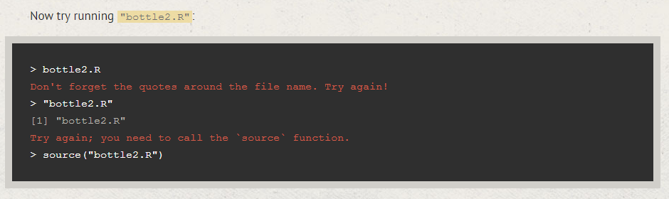
Additional Resources to Support Learning
Interactive step-by-step tutorial on basic R concepts
https://www.codeschool.com/courses/try-r
Topics: Using R, Vectors, Matrices, Summary Statistics, Factors, Dataframes, Real-World Data
Notes:
CC

Slide 68
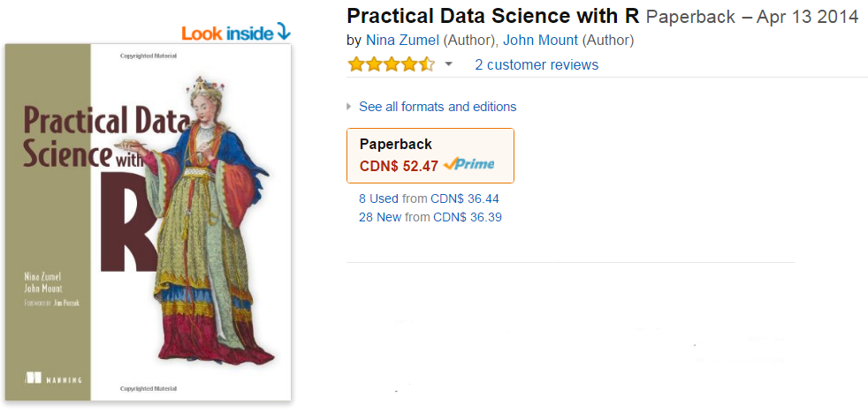
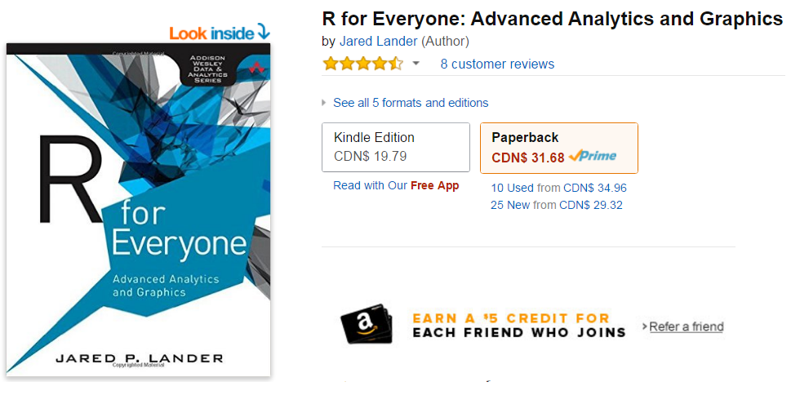
Additional Resources to Support Learning
Searching “R” on Amazon will give you great selection of reference books
Notes:
CC

Slide 69

Wrap Up

Slide 70
What Should You Know
With any luck, you should feel much more comfortable with R.
What is R? Why is it popular?
What is a package and how do I use them?
Data and object types in R
Import/Export of Data
Manipulating Data
Key Functions
Other Resources

Slide 71
Next Up
For the next session, we will cover the following items:
Visualization in R
Advanced Programming – Creating Functions and Macros
Apply Statements, Loops and For Statements
Predictive Modeling in R
Markdown

Slide 72
Appendices

Slide 73
Playing with Factors
We’ve previously touched about Factors, but let’s look at them in detail
First column of the data is an integer, but it’s also an ordered factor
If you ever try to sort this table using “Tree” number, it will actually sort by the orders of factor levels (i.e. 3 will come before 1)
We can re-order the factor to avoid complications later
> is(Tree)
[1] "ordered" "factor" "integer" "oldClass" "numeric" "vector"
[7] "data.frameRowLabels"
> Tree
[1] 1 1 1 1 1 1 1 2 2 2 2 2 2 2 3 3 3 3 3 3 3 4 4 4 4 4 4 4 5 5 5 5 5 5 5
Levels: 3 < 1 < 5 < 2 < 4
> Tree <- factor(Tree, levels=c(1:5))
> Tree
[1] 1 1 1 1 1 1 1 2 2 2 2 2 2 2 3 3 3 3 3 3 3 4 4 4 4 4 4 4 5 5 5 5 5 5 5
Levels: 1 < 2 < 3 < 4 < 5
Notes:
CC

Slide 74
SQLDF
Before using SQLDF, ensure all the columns in your Dataframe is named
Now you can simply query your Dataframe!
> names(Orange)
[1] "Tree" "age" "circumference"
> install.packages (“sqldf”)
> library (sqldf)
> res <- sqldf('select distinct age, avg(circumference) from Orange group by age')
> res
age avg(circumference)
1 118 31.0
2 484 57.8
3 664 93.2
4 1004 134.2
5 1231 145.6
6 1372 173.4
7 1582 175.8
Notes:
CC

Slide 75
dplyr
Powerful data manipulation package, examples of functions include:
filter() - subset the data based on rows you specify
select() – subset the data based on columns you specify
arrange() – re-orders the Dataframe by sorting the data based on rows
distinct() – returns unique records in the Dataframe
mutate() – append columns by performing arithmetic on existing columns
sample_n() – take random sample of rows (i.e. observations)
...And more!
Notes:
CC

